Slide 1


Learning & Talent Transformation
Learning and Knowledge Management
Data Migration Concepts

Slide 2
Agenda
Introduction to Data Migration
Types of Data Migrations
Data Migration Process
Challenges & Best Practices
Tools & Technologies
Data Migration Tools
Data Migration Techniques
Comparison of Migration Tools
Case Studies

Slide 3
Agenda
On-Premise Data Migrations
On-Premise Migration Strategies
Challenges in On-Premise Migrations
Best Practices for On-Premise Migrations
Case Studies in On-Premise Migrations
Cloud Data Migrations
Cloud Migration Strategies
Challenges in Cloud Migrations
Best Practices for Cloud Migrations
Cloud Migration Tools
Security Considerations in Cloud Migrations
Case Studies in Cloud Migrations
Future Trends in Data Migration

Slide 4
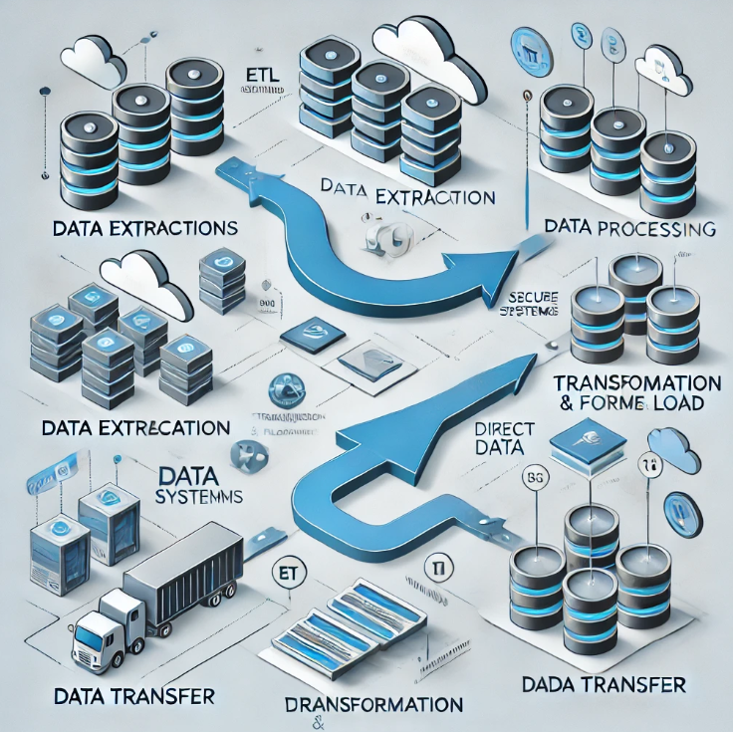
Introduction to Data Migration
Data Migration is the process of moving data from one system, format, or location to another.
Why is it important?
System upgrades
Cloud migrations
Mergers & acquisitions
Compliance & regulatory needs

Slide 5
Types of Data Migrations
Storage Migration
Moving data between storage devices.
Database Migration
Transferring data from one database to another.
Application Migration
Shifting data between applications or software platforms.
Cloud Migration
Moving data to/from/on different cloud platforms.
Business Process Migration
Transitioning entire workflows and related data.

Slide 6
Data Migration Process
Planning
Define scope, requirements & risks.
Assessment
Analyze data sources & dependencies.
Data Extraction
Retrieve data from the source system.
Transformation & Cleansing
Convert and validate data.
Loading & Testing
Load data into the target system and verify.
Deployment & Monitoring
Ensure data integrity post-migration.

Slide 7
Challenges & Best Practices
Challenges:
Data Loss & Corruption
Downtime & Performance Issues
Compatibility & Integration Issues
Security & Compliance Risks
Best Practices:
Perform Data Audits
Implement Backup Strategies
Conduct Testing & Validation
Use Automation Tools

Slide 8
Tools & Technologies
ETL Tools:
Informatica, Talend, Apache Nifi
Cloud Services:
AWS Data Migration Service, Azure Migrate
Database Migration Tools:
Oracle GoldenGate, AWS DMS
Testing & Validation:
QuerySurge, Data Loader

Slide 9
Data Migration Tools
On-Premise Tools:
IBM InfoSphere, Microsoft SSIS
Cloud-Based Tools:
Google Cloud Dataflow, Snowflake
Hybrid Tools:
Dell Boomi, MuleSoft
Open-Source Tools:
Apache Kafka, Pentaho

Slide 10
Data Migration Techniques
Big Bang Migration:
Moving all data in one go.
Trickle Migration:
Gradual migration with minimal downtime.
ETL (Extract, Transform, Load):
Structured process for data migration.
Replication-Based Migration:
Continuous syncing of old and new systems.
Hybrid Approaches:
Combining multiple methods for efficiency.

Slide 11
Comparison of Migration Tools
Tool | Type | Best For | Features
AWS DMS | Cloud | Large-scale migrations | Automated schema conversion
Talend | ETL | Data transformation | Open-source flexibility
Oracle GoldenGate | Database | Real-time replication | High availability
Apache Kafka | Open-Source | Streaming migrations | High throughput

Slide 12
Case Studies
Company A:
Migrating from legacy systems to cloud
Company B:
Implementing a hybrid cloud migration strategy
Company C:
Large-scale enterprise data warehouse migration

Slide 13
On-Premise Data Migration

Slide 14
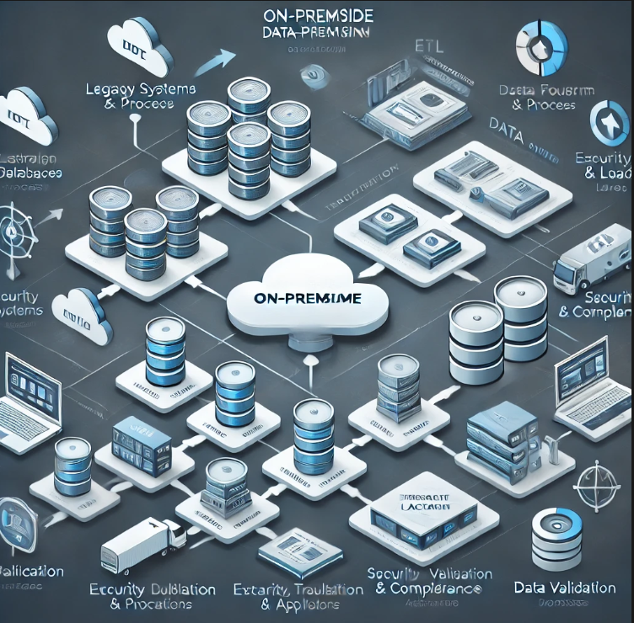
On-Premise Data Migrations
Moving data within an on-premise environment without leveraging cloud solutions.
Common Use Cases:
Data center consolidation
Upgrading storage infrastructure
Merging databases for enterprise systems
Key Benefits:
Greater control over data security
No dependency on internet connectivity
Customization options tailored to business needs

Slide 15
On-Premise Migration Strategies
Lift and Shift:
Moving data as-is to a new on-premise system.
Re-platforming:
Making minimal modifications while migrating.
Rehosting:
Deploying existing applications in a new infrastructure.
Data Replication:
Copying data across multiple storage devices.
Incremental Migration:
Moving data in phases to reduce downtime.

Slide 16
Challenges in On-Premise Migrations
Hardware Limitations:
Ensuring compatibility between old and new infrastructure.
Downtime Risks:
Managing business continuity during migration.
Data Integrity Issues:
Preventing corruption or loss of critical data.
Scalability Concerns:
Ensuring future-proof solutions post-migration.
Security Compliance:
Adhering to regulatory policies for data handling.

Slide 17
Best Practices for On-Premise Migrations
Conduct thorough pre-migration assessments.
Develop a rollback plan in case of failures.
Use automation tools to streamline migration.
Perform rigorous testing before full deployment.
Train IT staff for better post-migration management.

Slide 18
Case Studies in On-Premise Migrations
Enterprise A:
Migrated legacy database to modern on-premise infrastructure.
Company B:
Consolidated multiple data centers into one.
Organization C:
Implemented incremental migration to minimize downtime.

Slide 19
Cloud Data Migration

Slide 20
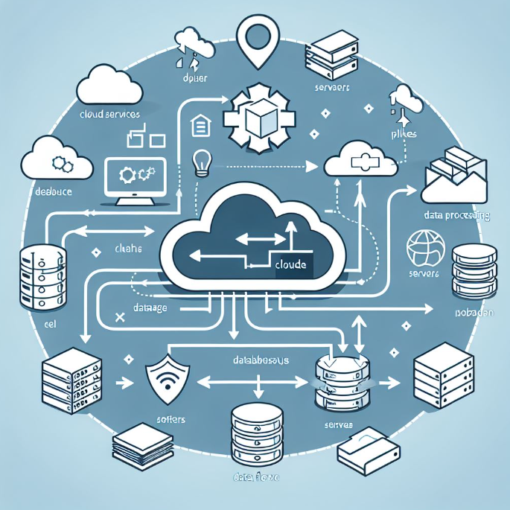
Cloud Data Migrations
The process of moving data, applications, and workloads to a cloud environment.
Why Cloud?
Scalability
Cost-efficiency
Business continuity
Security and compliance
Types of Cloud Migrations:
On-Premise to Cloud
Cloud-to-Cloud
Hybrid Cloud Migration

Slide 21
Cloud Migration Strategies
Rehosting (Lift and Shift):
Moving applications without modifications.
Re-platforming:
Making minimal optimizations for cloud efficiency.
Refactoring:
Re-architecting applications to leverage cloud-native features.
Repurchasing:
Moving to a new cloud-based software solution (SaaS).
Retiring:
Decommissioning outdated applications during migration.
Retaining:
Keeping certain systems on-premise due to regulatory or business needs.

Slide 22
Challenges in Cloud Migrations
Data Security & Compliance Risks
Downtime & Business Continuity Concerns
Integration with Legacy Systems
Latency & Performance Issues
Cost Management & Unexpected Expenses
Cloud Vendor Lock-in

Slide 23
Best Practices for Cloud Migrations
Perform a thorough pre-migration assessment.
Develop a phased migration strategy.
Implement robust security and compliance frameworks.
Optimize workloads for cloud performance.
Conduct rigorous testing before full deployment.
Train teams for cloud operations and management.

Slide 24
Cloud Migration Tools
Cloud-Native Tools:
AWS Migration Hub, Azure Migrate, Google Cloud Migrate
Third-Party Tools:
CloudEndure, Carbonite Migrate, RiverMeadow
ETL & Data Pipelines:
Apache NiFi, Talend, Informatica
Monitoring & Testing:
Datadog, New Relic, CloudHealth

Slide 25
Security Considerations in Cloud Migrations
Data Encryption at Rest & In Transit
Identity & Access Management (IAM)
Regular Compliance Audits
Disaster Recovery & Backup Strategies
Multi-Factor Authentication (MFA) Implementation
Continuous Monitoring & Threat Detection

Slide 26
Case Studies in Cloud Migrations
Company A:
Large-scale enterprise cloud migration for cost reduction.
Company B:
Hybrid cloud migration strategy to balance flexibility.
Company C:
SaaS migration to enhance business agility.

Slide 27
Future Trends in Data Migration
AI & Machine Learning in Migration
Automation & Self-Healing Migrations
Serverless Data Migration Solutions
Security-First Migration Approaches

Slide 28
Knowledge Check 1
What are the key benefits of cloud data migration?
A. Increased Scalability and Cost Efficiency
B. Higher Downtime and Increased Costs
C. Limited Business Continuity and Security Risks
D. No Compliance Requirements
Notes:
Answer: A. Increased Scalability and Cost Efficiency

Slide 29
Knowledge Check 2
Which of the following is NOT a cloud migration strategy?
A. Rehosting (Lift and Shift)
B. Replatforming
C. Refactoring
D. Data Deletion
Notes:
Answer: D. Data Deletion

Slide 30
Knowledge Check 3
Which of these is a common challenge faced during cloud migrations?
A. Zero latency issues
B. Data security & compliance risks
C. Unlimited budget and resources
D. No need for business continuity planning
Notes:
Answer: B. Data security & compliance risks

Slide 31
Knowledge Check 4
What is the primary purpose of cloud migration tools like AWS Migration Hub and Azure Migrate?
A. To delete unnecessary data
B. To assist in migrating workloads and data efficiently
C. To increase manual workload during migration
D. To prevent organizations from using cloud services
Notes:
Answer: B. To assist in migrating workloads and data efficiently

Slide 32
Knowledge Check 5
Which best practice should be followed to ensure a successful cloud migration?
A. Ignoring security considerations
B. Implementing a phased migration strategy
C. Avoiding compliance audits
D. Migrating everything in one go without testing
Notes:
Answer: B. Implementing a phased migration strategy

Slide 33
Any question ?

Slide 34
Summary of Key Takeaways
In this session we have discussed about –
What is Data Migration
Types of Data Migrations
Data Migration Process
Challenges & Best Practices
Tools & Technologies
Data Migration Tools
Data Migration Techniques
Comparison of Migration Tools
Case Studies

Slide 35
Summary of Key Takeaways
In this session we have discussed about –
On-Premise Data Migrations
On-Premise Migration Strategies
Challenges in On-Premise Migrations
Best Practices for On-Premise Migrations
Case Studies in On-Premise Migrations
Cloud Data Migrations
Cloud Migration Strategies
Challenges in Cloud Migrations
Best Practices for Cloud Migrations
Cloud Migration Tools
Security Considerations in Cloud Migrations
Case Studies in Cloud Migrations
Future Trends in Data Migration

Slide 36


Thank you!

